Slide 1
Compressed Texture Transmission Format
Mark Callow
David Wilkinson
Siggraph Asia, Tokyo, Dec 4th, 2018

Slide 2
Required Specifications
Format(s) for the image bits
Container
Textures usually consist of multiple images
A container makes for easier use.
Header
Image 1
Image n
Notes:
Examples of multi-image textures: mipmap pyramids, cubemaps, arrays and 3d textures (a.k.a volumes)

Slide 3
Image Bits - Issues
Can use image formats defined by the GPU APIs but
uncompressed formats too large for transmission
block-compressed formats suboptimal for transmission
JPEG- & webp-compressed files can’t be randomly accessed
Compression to GPU formats unavailable on most clients and slow
A googol¹ of GPU/Platform-Specific formats. Nightmare!
1. 10¹⁰⁰
Notes:
GPU block-compressed formats are designed for random access to the texels.
A blank texture with no information still requires transmission of all the blocks.
Natural thought is to decompress JPEG images and recompress to a block-compressed format but it is impractical. Same issues for webp, etc.

Slide 4
Image Bits - Solving Transmission Size
Supercompression
Rate Distortion Optimization (Crunch RDO Mode)
Image
BC[1-5], ETC[12], ASTC 4x4
RDO
{LZ,zStandard}
Inflate
GPU
Crunch (Crunch CRN mode)
Image
BC[1-5], ETC[12], ASTC{4x4,6x6}
Crunch
Decrunch
GPU
Notes:
Super here has similar meaning to its use in superscript or superimpose - to layer over. It does not mean some new supercalifragilisticexpealidocious compression mode.
Crunch, originally developed to compress BC 1-5 (DX 1-5) format textures, has been around a few years. Recently it has been extended to support ETC formats. It’s inventor, Rich Geldreich, has founded Binomial whose product Basis does similar things.
—— Click to show RDO —-
In RDO mode, Crunch quantizes the "raw BC1-5 or ETC bits" using clusterization and vector quantization (VQ) to lower their entropy, allowing LZ style codecs to better exploit the redundancy in the texture data.
Advantage: you don't need to ship any special code in your app because you most likely are LZ'ing the raw texture data anyway.
We believe there is room for improvement in RDO mode. It has never really been optimized and Basis’s RDO mode provides “much better quality” according to Rich. Apparently is has a built in mini-LZ step.
—— Click to show CRN —-
In CRN mode, Crunch quantizes the endpoints and selector data of the BC or ETC data using clusterization and vector quantization. The image bitstream consists of compressed endpoint/selector codebooks, and Huffman compressed per-block indices referring into these codebooks. It's a very efficient encoding, around .75-1.75 bits/texel, with user control over the quality vs. bitrate tradeoff. It's just as strong or stronger than RDO+Zstd now and does not require any additional lossless compression step.
With both of these we’re approaching jpeg levels of compression.
The same techniques could be applied to BC6&7 & ASTC.
The same techniques could be applied to BC6&7 & ASTC.

Slide 5
Image Bits - Solving the Googol of formats
Universal Transcodable Format
Image
Transcodable format (ETC1S)
Crunch (CRN)
}
ASTC{4x4,6x6,8x8}¹
BC[1-5],
ETC[12]²,
PVRTC
Decrunch
Transcode
GPU
Can be combined for better performance
Work in Progress. Code not yet in repo.
No transcode necessary
Notes:
Crunch CRN mode is applied to a universal transcodable format.
The initial "Rosetta stone" universal format, is a subset of ETC1 called ETC1S. It uses no flips and disables individual modes, i.e. each 4x4 block has a single 5:5:5 color, a 3-bit table index, and 16 selectors. This is easily transcodable to all other GPU formats.
This baseline format's quality is BC1/ETC1 (not awesome but good enough for web). Alpha uses two ETC1S blocks. Implementation with this baseline provides a starting point for improvements and testing other technology. The experts see many possibilities for improvement.
The final "transcoder" part is a small blob of C++ code executed on the device's CPU. This step could be done in WebAssembly or in shader code. This code unpacks the codebooks into a temp buffer, then it unpacks a mip level's compressed block data (which refer to the endpoint/selector codebooks) and passes them to the specific GPU transcoder the caller has selected. The data can be transcoded to any other format very quickly using simple table lookups. It allows random access to individual mip levels once the codebooks are unpacked.
Importantly, excluding PVRTC there is no RGB(A) pixel level processing in the transcoder -- just simple per-block endpoint/selector processing. As WebAssembly doesn't support vector intrinsics yet, the transcoders are optimized to use simple scalar ops. Transcoding to PVRTC needs two passes. The PVRTC transcode step's selector pass is the slower part.

Slide 6
Quality
Will show comparison tests later.
ETC1S is a 64-bit 4x4 block universal format
Limited to an upper bound bitrate of 3.125bpp
Works very well for transcoding to BC1-5, ETC1, PVRTC, ASTC{4x4,8x8}, BC7 (mode 6)
Natural images encode very well due to inherent redundancy
Hard edges, icons, or ultra fine details will not encode well
Fallback to LZ compression often works well in these cases...
But requires inflation on the target
Support for new and higher quality formats will be added in incremental revisions: ETC2, ASTC HDR & BC6H/BC7.
Support for variable block sizes & partitions to follow in incremental revisions
Notes:
Hard-edged and highly detailed artwork suffers due to the blocking artifacts of ETC1S.
LZ may be sufficient on its own or there may be an alternative transform that could be applied to reduce entropy prior to the LZ step. T.B.D.

Slide 7
ASTC Transcoding
Some unique challenges
ETC1S universal format has 64-bit 4x4 texel blocks
ASTC has 128-bit blocks with different texel layouts
We have to encode our source image to a maximum bitrate of 3.125bpp ‼️
While preserving enough detail to ensure good quality when transcoding to ASTC
How to make ASTC fit into the Universal Format?
To fit within 3.125bpp, apply state-of-the-art VQ to the source image
Experiments show high quality results for ETC1S→ASTC4x4 across a large sample set
ASTC{6x6,8x8} can also be supported, but require more complex transcoders
Certain image types do not encode well to ETC1S despite best efforts
For these cases the only solution is a higher quality universal format…
CTTF V2.0 will feature a wide universal format
Lossless universal representation for high-precision, HDR texture data
All ASTC block sizes can be encoded and transcoded without incurring quality loss

Slide 8
ETC1S and ASTC - Quality Comparison
ETC1S Universal Format vs. ASTC{4x4,6x6,8x8} LZMA packed bitstream
Encoding Stage
Source Image Encoding | Luma PSNR (dB) | Bitrate (bpp)
ASTC4x4 | 51.20 | 6.67
ASTC6x6 | 44.04 | 3.18
ASTC8x8 | 39.91 | 1.84
ETC1S | 38.88 | 1.57
Transcoder Stage
Transcoder | Luma PSNR (dB)
ETC1S->ASTC4x4 | 38.88
ETC1S->ASTC6x6 | 38.27
ASTC4x4 has superior quality, but poor bitrate
ASTC6x6 has good image quality, but twice the bitrate of ETC1S
ASTC8x8 is effectively equivalent to ETC1S in quality and bitrate
ETC1S yields the lowest bitrate, and good image quality
ETC1S maps easily to ASTC4x4 - real-time, lossless transcode
ASTC6x6 does not map well, transcoder is complex,lossy, SLOW!
Only use ASTC6x6 if you need the lower device memory footprint
Use ASTC4x4 transcoder for best performance!!
Notes:
Note: bitrate numbers are for the LZMA-packed bitstream.

Slide 9
KTX1 File Structure
Header
Meta
data
Mip level 0
Mip level n
Notes:
KTX is a Khronos Group specification.
It is basically an array of mip levels.

Slide 10
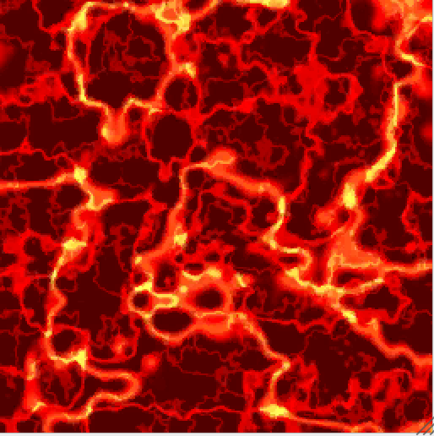
KTX1 File Structure
Header
Meta
data
Mip level 0
Mip level n
Array layer 0
Array layer n
face / z-slice 0
face / z-slice n
face / z-slice 0
face / z-slice n
Mip Level Structure
Notes:
A mip level contains all the layers and face-slices for that level so a single KTX file contains all levels, layers and face-slices for a texture.
face-slice means a cube map face or a z-slice of a 3D texture.

Slide 11
KTX2 File Structure
Header
Data Format Descriptor
Meta
data
Super-compression Global Data
Mip level 0
Mip level n
Header Additions
supercompressionScheme
vkFormat
levelOrder
Metadata Additions
KTXcubemapIncomplete
KTXswizzle
KTXwriter
Notes:
Structure is same as KTX1 except for addition of DFD, supercompression Global Data, some header fields and some metadata.
Mip level structure is unchanged. Note that mip levels are supercompressed independently allowing for random access.
Header Additions. Currently discussing removing the glInternalformat, glFormat and glType fields.
Meta Data Additions. We’ve also changed the format of the KTXorientation value.

Slide 12
KTX2 Header Additions: Supercompression
supercompressionScheme
Deflate (a.k.a zlib)
Zstandard
Crunch CRN mode
Notes 💁🏻‍♂️
Typically use Deflate & Zstandard only with Crunch RDO-mode-processed or uncompressed images.
Use CRN for supercompression of block-compressed textures.
Transcodable format is supercompressed using CRN.

Slide 13
KTX2 Header Additions: Others
vkFormat field
makes loading of Vulkan textures easier
levelOrder field
lets mip levels be ordered from smallest first, enabling streaming
Notes:
Because mip levels are supercompresssed independently, can send smaller levels first.

Slide 14
Data Format Descriptor¹
Exact description of texel format and color space
non-OpenGL and non-Vulkan applications can use the image data without understanding OpenGL or Vulkan enums
can describe multi-sample images opening the door to saving & loading them. KTX2 support is under discussion.
applications that care can do color correction
See https://www.khronos.org/dataformat.
Notes:
The APIs don’t accept multisample formats so there are no enums. But DFD can describe them. Shaders can be used to load them.
Whether to support multi-sample in KTX2 is currently under discussion.

Slide 15
DFD Color Space Information
Enums are provided to identify
common primaries
BT709/sRGB, BT2020, Display P3, Adobe RGB & more.
common transfer functions
Linear¹, sRGB¹, ITU (BT 601, 709 & 2020), Adobe RGB & more
A full ICC profile could be incorporated via a KDFS extension
D3D/OpenGL/Vulkan/WebGL support only Linear & sRGB in hardware
Notes:
Color management is a complex topic that needs its own presentation.
Suffice it to say, having color space information embedded in the image file is a fundamental requirement for managing color in a workflow.
Non-CTTF users of KTX2 may wish to use one or more of the common color spaces. Most color transforms can be done in shaders.
But because colors should be converted to linear space before filtering (unless doing nearest neighbor sampling and the rest of the pipeline is set up correctly), dealing with transfer functions other than sRGB is an issue.
So most likely the CTTF will recommend or require that all color images used should have an sRGB or linear transfer function. Images can be converted to one of those spaces before transmission.

Slide 16
Metadata Additions
KTXcubemapIncomplete
Indicates which faces are present and absent when packaging an incomplete cubemap as a 2D array texture.
KTXswizzle
Indicates desired component mapping for a texture with color components.
KTXwriter
File writer should identify itself with this.
Notes:
All 6 faces are required for cube map textures.

Slide 17
CTTF Status
KTX2 ready for trial implementation by end of 2018.
KHR_texture_transmission v1.0 Provisional spec in Q1 2019.
Universal supercompressed transcodable format
Target device transcodes to its own native GPU format in real-time
'RDO mode' - allows custom target bitrate (compression ratio vs quality tradeoff)
Only standard GPU formats supported for now [BC1-5, ETC1, PVRTC, ASTC LDR subset]
Works in Progress
CRN supercompressed bitstream specification document
ASTC{4x4,6x6,8x8} transcoders and encoder enhancements
Wide Universal Format Proposals (128/256-bit variable block size and tile support)
Incremental spec revisions
Introduce support for variable block sizes and wide formats: ASTC, BC6H/BC7, HDR
Streaming functionality enhancements
New minor revisions will not introduce breaking changes

Slide 18
Call for Industry Collaboration!
Actively seeking industry feedback and contributions
Development is open to the community - github links to specs, libs & samples to follow
Consider participating directly in the Khronos 3D Formats WG!

Slide 19
File Issues & Suggestions in GitHub
KTX2 Issues:
https://github.com/KhronosGroup/KTX-Specification/issues
Compression Tools & Transcoder Issues:
https://github.com/KhronosGroup/glTF-Texture-Transmission-Tools/issues
CTTF glTF Extension Issues (no draft & no issues yet):
https://github.com/KhronosGroup/glTF/issues
There may be some overlap in issues among these repos.
Some KTX2 issues, mostly resolved, are listed at end of the specification:
http://github.khronos.org/KTX-Specification/

Slide 20
Your Input Requested for these KTX2 Issues
Issue № 8
Tighten Vulkan / GL enums
Should we remove glInternalformat, glFormat & glType?
Issue № 14
How to handle type-awareness disparity between DFD and `VkFormat`
Should we make KTX2 always little-endian?
Issue № 27
Support multi-sample images?
If so, how would they be used?
Please chime in. We want your opinion. Once nos. 8 & 14 are resolved KTX2 will be ready for trial implementation.

Slide 21
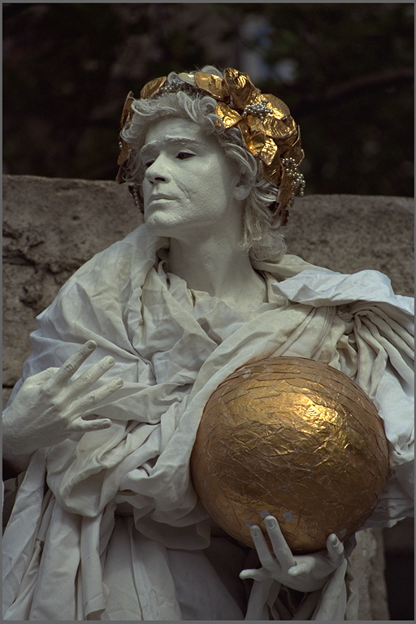
Reference DXT1 vs. CTTF Comparison Tests
Quality comparisons of a reference DXT1 image vs equivalent CTTF encodings
Reference DXT1 image created with Crunch encoder
CTTF bitrates set to best match reference DXT1 quality
Test 1: Reference DXT1 vs CTTF ETC1S-CRN transcoder
Test 2: Reference DXT1 vs CTTF RDO+LZMA
Test 3: CTTF mode comparison: ETC1S-CRN vs RDO+LZMA

Slide 22
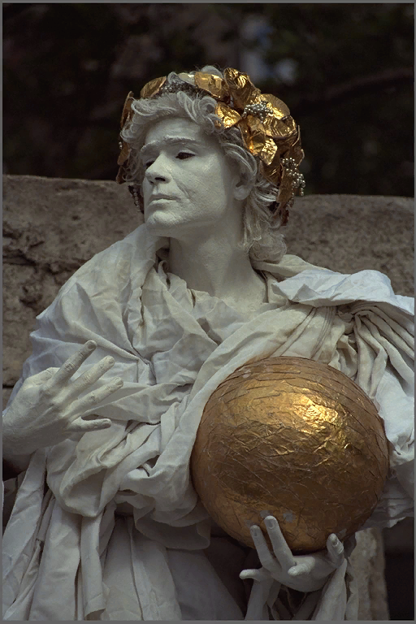
DXT1 vs. CTTF ETC1S-CRN Transcoder
Format | DXT1 | CTTF ETC1S-CRN
Transmitted bits/pixel | 4.0 | 1.8*
Stream Compression | 6:1 | 13:1
PSNR (dB) | 37.78 | 36.32
MSE¹ | 10.83 | 15.19
SSIM² | 0.97 | 0.96
*Best bitrate setting to approx ref DXT1 PSNR
1 Mean Squared Error
² Structured Similarity Index
DXT1
ETC1S-CRN -> DXT1

Slide 23
DXT1 vs. CTTF RDO+LZMA (DXT1)
Format | DXT1 | CTTF RDO+LZMA
Transmitted bits/pixel | 4.0 | 2.1*
Stream Compression | 6:1 | 11:1
PSNR (dB) | 37.78 | 36.45
MSE | 10.83 | 14.71
SSIM | 0.97 | 0.95
*Best bitrate setting to approx ref DXT1 PSNR
DXT1
Unpacked RDO DXT1

Slide 24
CTTF Mode Comparison- ETC1S-CRN vs.RDO+LZMA (DXT1)
Format | CTTF ETC1S-CRN | CTTF RDO+LZMA
Transmitted bits/pixel | 1.8 | 2.1
Stream Compression | 13:1 | 11:1
PSNR (dB) | 36.32 | 36.45
MSE | 15.19 | 14.71
SSIM | 0.96 | 0.95
CTTF RDO mode + LZMA does not give as high
compression perf as ETC1S-CRN. However, given that
it is just an optimizing DXT encoder, the resulting
texture can be used by DXT-supporting devices
without modification
ETC1S-CRN has better compression with no extra
encoder stage needed, but requires work to integrate
universal format support into existing DXT workflows
ETC1S-CRN -> DXT1
Unpacked RDO DXT1

Slide 25
Acknowledgements
David Wilkinson, AMD | 3d Formats Texture Transmission TSG Chairman. Compressonator glTF CTTF/KTX2 Integration
Rich Geldreich, Binomial | Core Technology Creator. Masochist.* 😉 * How else to describe someone with the willingness & stamina to wade through enormously long compressed texture format specs looking for commonalities? 🤯
Alexander Suvorov, Unity | Crunch support for ETC{,2} & performance improvements.
Andrew Garrard, Samsung | Khronos Data Format Specification Guru.
Alexey Knyazev, Independent | glTF Integration Expert. Provides invaluable help tightening the KTX2 specification.
Patrick Cozzi, Cesium | 3D Formats WG Chairman.

Slide 26
Watch these places for progress
Crunch & Transcoders: https://github.com/KhronosGroup/glTF-Texture-Transmission-Tools.
Texture Compression SDK: https://github.com/KhronosGroup/glTF-Compressonator.
Samples & Test Data: https://github.com/KhronosGroup/glTF-Texture-Transmission-Samples.
Readable KTX2 specification: https://github.khronos.org/KTX-Specification/.
KTX specification source: https://github.com/KhronosGroup/KTX-Specification.
KTX software (currently only supports KTX1): https://github.com/KhronosGroup/KTX-Software.
Original Crunch GitHub Repo: https://github.com/BinomialLLC/crunch. Use the fork above.
Blogs
Alexander Suvorov on his improvements to Crunch to support ETC:
https://blogs.unity3d.com/2017/12/15/crunch-compression-of-etc-textures/
Rich Geldreich on the “universal format” and the transcoders
http://richg42.blogspot.com/2018/06/etc1s-texture-format-encoding.html
http://richg42.blogspot.com/2018/05/some-basis-baseline-universal-format.html

Slide 27
Supplemental Material

Slide 28
DXT1 vs. CTTF ETC1S-CRN Transcoding
Quality and Risk Analysis
Note how the ETC1S-CRN transcodable format compresses better than an RDO+LZMA DXT
Highly compact - potentially up to 4x smaller than equivalent GPU format encoding
Supercompression is gained through a set of entropy reduction stages + clusterization +VQ
ETC1S-CRN also features an implicit RDO stage - so quality vs bitrate can be controlled
Supporting ETC1S-CRN requires changes to existing asset pipelines and app code - some risk
Unlike CTTF RDO mode, where the optimized DXT textures can be used as-is - no risk

Slide 29
DXT1 vs. CTTF RDO+LZMA mode
Quality and Risk Analysis
Note performance slides showed RDO+LZMA mode performing WORSE than ETC1S-CRN!
ETC1S-CRN applies supercompression on encode, so no need for a lossless encoding stage
RDO mode adjusts bitrate of encoded DXT to desired level, for use with a lossless encoder
Works with existing workflows - no changes to asset pipelines or app code, zero risk
Unlike the ETC1S-CRN universal format, which would require integration into tools and apps

Slide 30
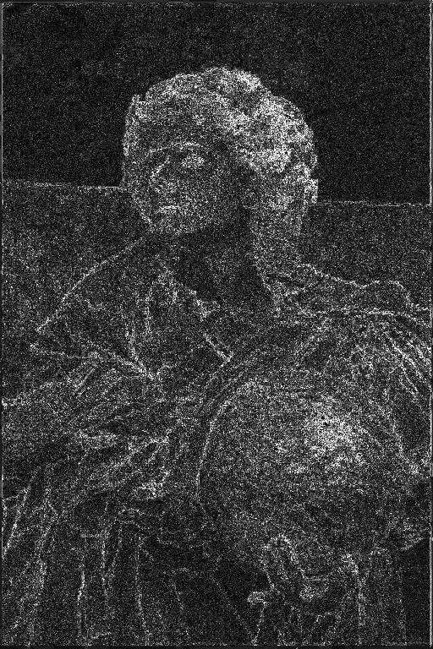
Bitstream Compression Performance
Transmission with standard DXT1 Encoding
Original
DXT Encode
DXT1
Diff
DXT1 Block
Encode
Transmission
DXT1
Texture Copy
Size: 512 x 768
Format: RGB8 RAW
Buffer Size: 1152KB
Size: 512 x 768
Format:DXT1 RGBA
Buffer Size: 192 KB
Size: 512 x 768
Format: DXT1 RGBA
Buffer Size: 192 KB
MSE: 10.8 PSNR: 37.8dB
Stream Compress: 6.1

Slide 31
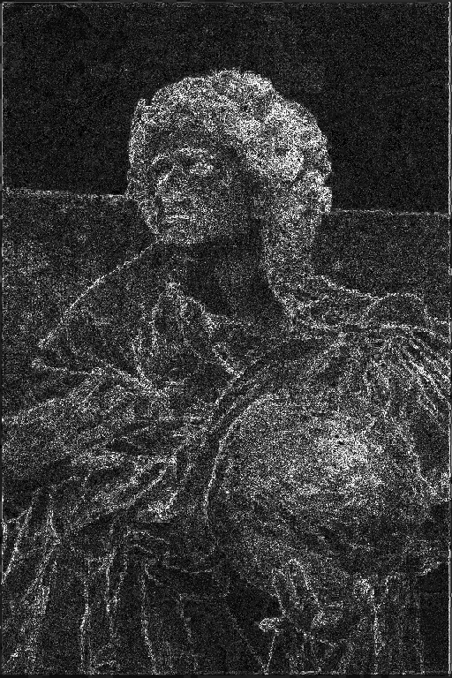
Bitstream Compression Performance
CTTF ETC1S-CRN bitstream with DXT1 transcode on receiver
Original
ETC1S-CRN
DXT1
Diff
ETC1S-CRN
Universal
Encode
Transmission
ETC1S-CRN
DXT1
Transcode
Size: 512 x 768
Format: RGB8 RAW
Buffer Size: 1152KB
Size: 512 x 768
Format: ETC1S-CRN
Buffer Size: 67 KB
Size: 512 x 768
Format: DXT1 RGBA
Buffer Size: 192 KB
MSE: 15.19 PSNR: 36.32dB
Stream Compress: 13:1

Slide 32
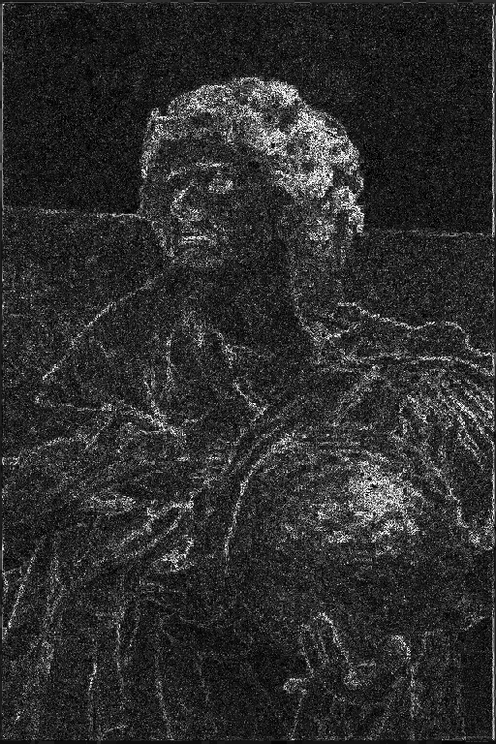
Bitstream Compression Performance
CTTF RDO+LZMA lossless DXT1 bitstream with unpack on receiver
Original
RDO+LZMA
DXT1
Diff
Rate-Dist
Clusterization
Generate DXT1
Texture
lzma pack
WIP
Transmission
lzma unpack
DXT1 Texture
Copy
Size: 512 x 768
Format: RGB8 RAW
Buffer Size: 1152KB
Size: 512 x 768
Format: LZMA
Packed Size:100K
Size: 512 x 768
Format: DXT1 RGBA
Buffer Size: 192 KB
MSE: 0.95 PSNR: 36.45dB
Stream Compress: 11:1

